Slide 1
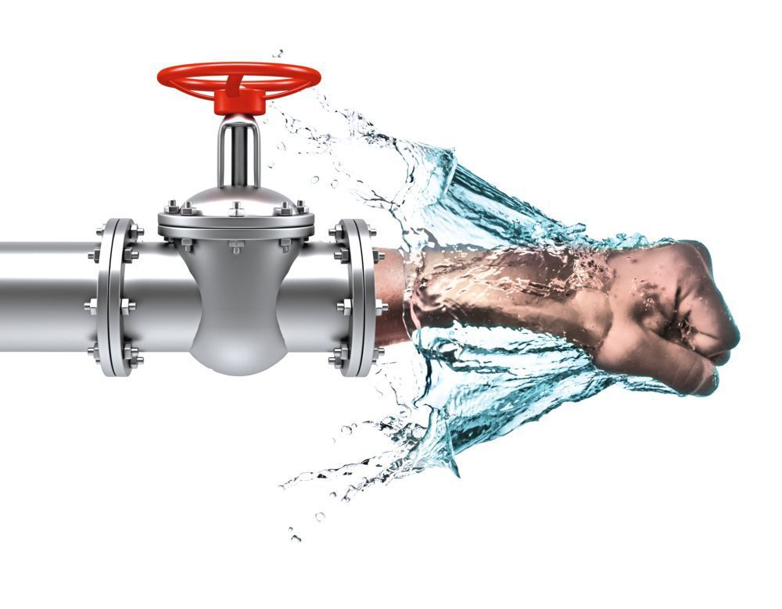
WATER HAMMER
1399

Slide 2
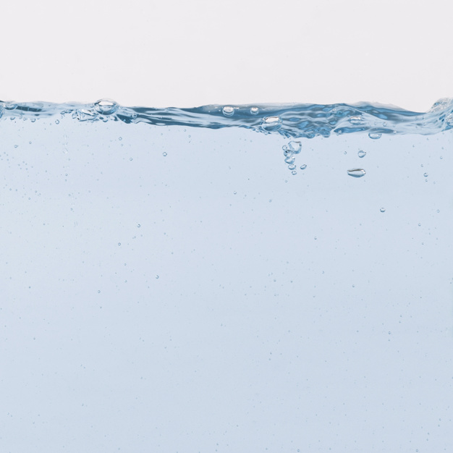
Contents
What is water hammer?.........................................................................................................................3
Where Water Hammer Occurs?.....................................................................................5
Conditions causing water hammer……………………………………….……….……………………6
The real force of the flow …………………………………………………………..…………………….8
When Should I Be Concerned …………………………………………………….……………………..9
effects of Water Hammer ……………………………………………………….…………………….10
devices for Protection from Water Hammer ……………………………………………………..12
Dft …………………………………………………………………………………………………………….. 15
Is water hammer also useful?....………………………………………………………………………16
Inclusions ………………………………………………………………………………………………….17
References……………………………………………………………………………………………………18

Slide 3

What is water hammer?

Slide 4
Introduction
Sound and impact
Damage
Control

Slide 5
What is Water Hammer?
Water Hammer is a shock wave that is transmitted through the fluid contained in a piping system
A water hammer commonly occurs when a valve closes suddenly at an end of a pipeline system, and a pressure wave propagates in the pipe. It is also called hydraulic shock.
In simple terms, Water Hammer occurs when a fluid in motion is forced to a sudden stop

