Slide 1
Strain and strain transformation

Slide 2
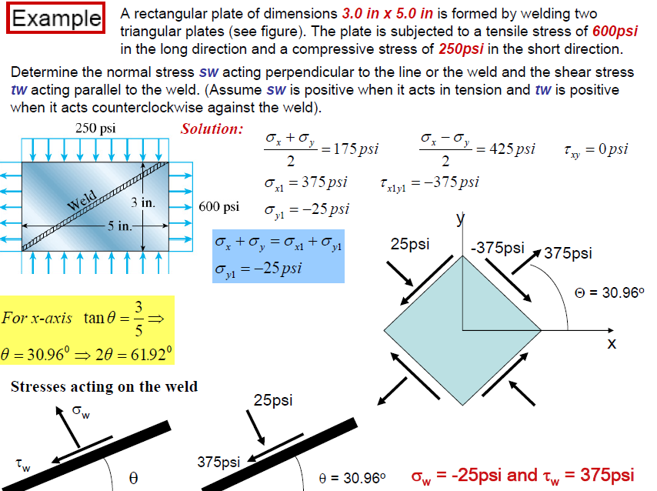

Slide 3
Introduction:
Applied forces induce internal forces, which induce stresses:
Stresses produce deformations because real materials are not infinitely rigid. Deformations are measured by strains.
Integration of strains through space gives displacements.
The relation between strains and stresses, which is given by material properties codified into the so-called constitutive equations, is studied in this lecture.
In general terms, strain is a macroscopic measure of deformation.

Slide 4
“The change in length and relative direction occasioned by deformation is called, loosely, strain.” [The term “strain” was introduced by W. J. M. Rankine in 1851.]
Classification
1. Average vs. Point. Average strain is that taken over a finite portion of the body; for example using a strain gage or rosette. Point strain is obtained by a limit process in which the dimension(s) of the gaged portion is made to approach zero.
2. Normal vs. Shear. Normal strain measures changes in length along a specific direction. It is also called extensional strain as well as dimensional strain. Shear strain measures changes in angles with respect to two specific directions.

